Slide 1
Development of a Diagonal Isometric Tensor Network Algorithm
Masters thesis
Benjamin Sappler

Slide 2
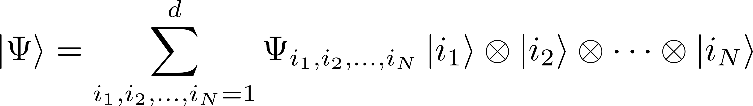
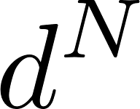
Simulation of QMB systems
Fully describe wavefunction: parameters!
Approximations are needed!

Slide 3
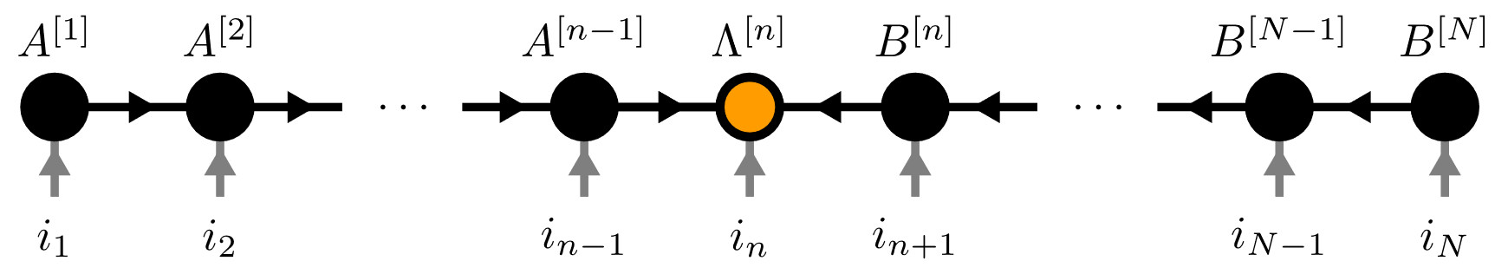
Contents
Matrix Product States (MPS)
Isometric Tensor Product States (isoTPS)
YB-isoTPS

Slide 4
Contents
Matrix Product States (MPS)
Isometric Tensor Product States (isoTPS)
YB-isoTPS

Slide 5

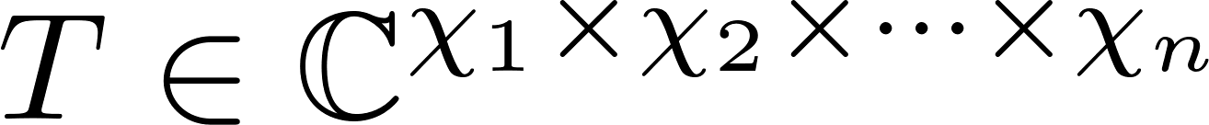
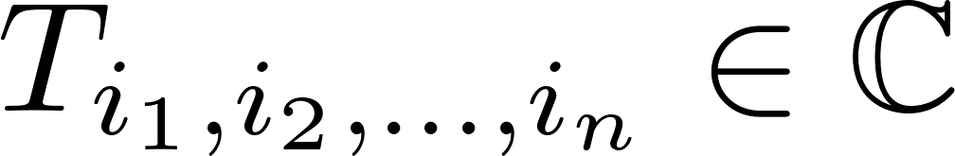
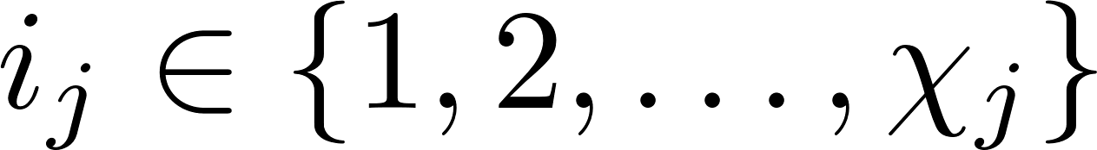
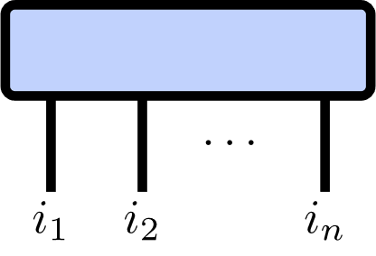
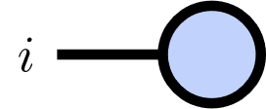
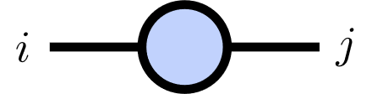
Tensor Networks
Tensor of rank :

Slide 6
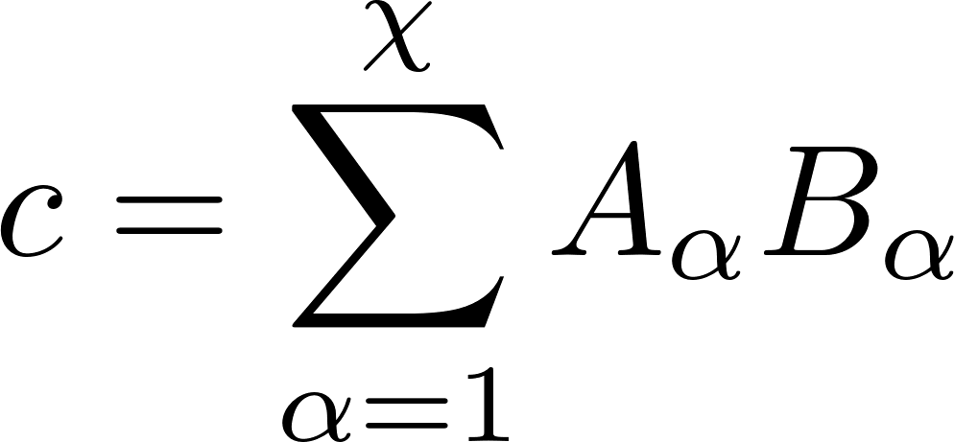
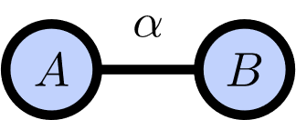
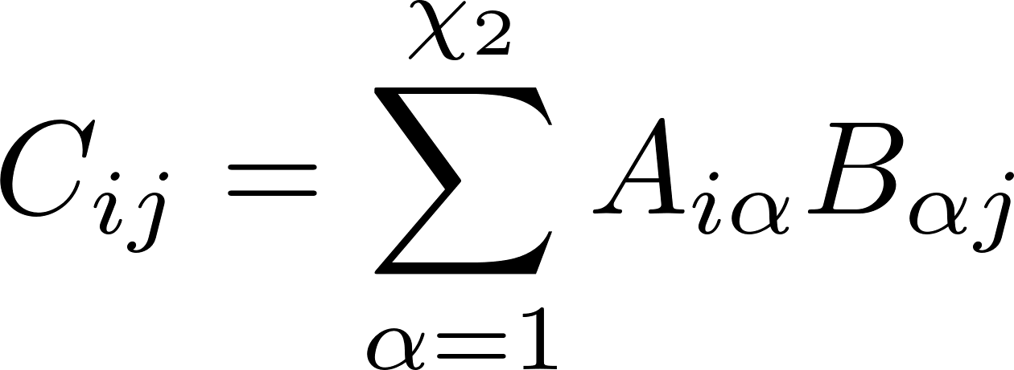
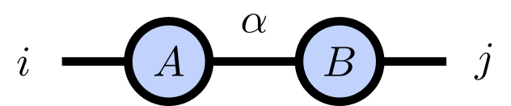
Index Contractions
Scalar product:
Matrix product:

Slide 7
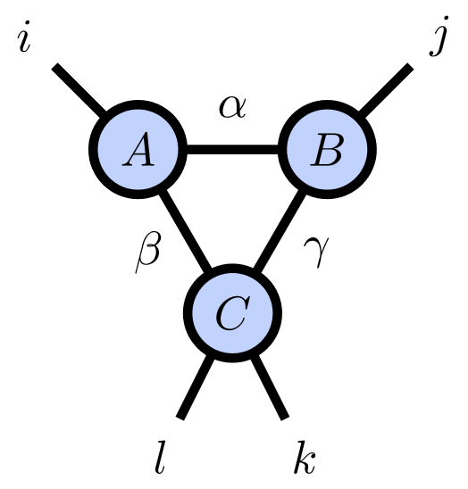
Index Contractions

Slide 8
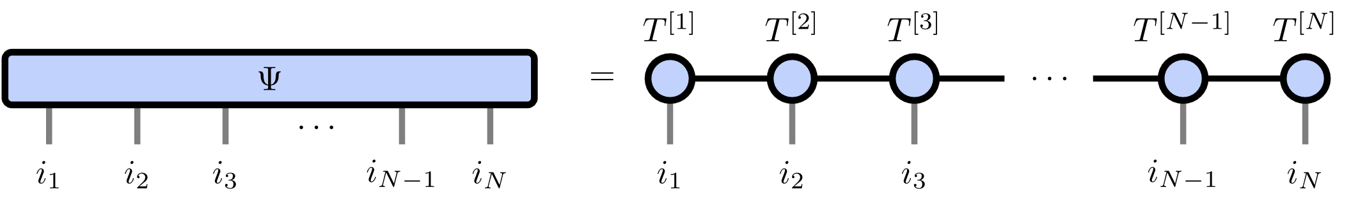
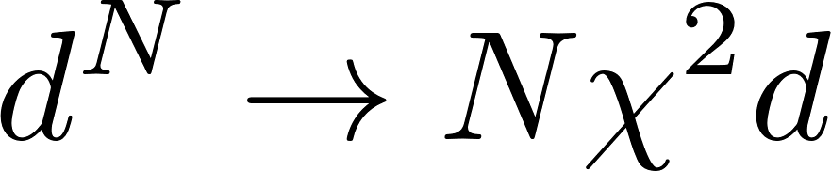
Matrix Product States
Number of parameters:

Slide 9
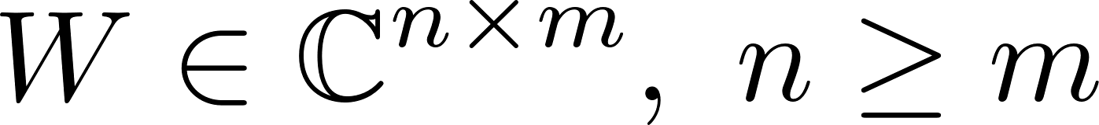
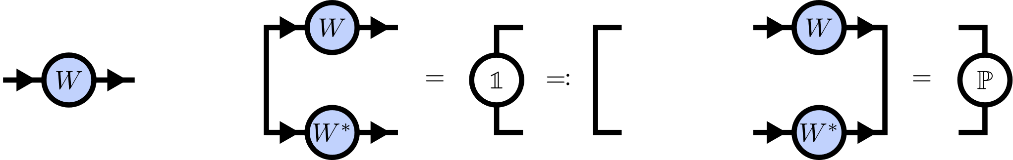
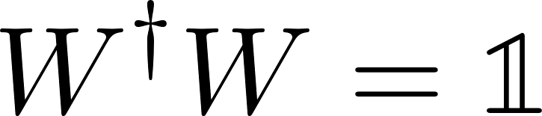
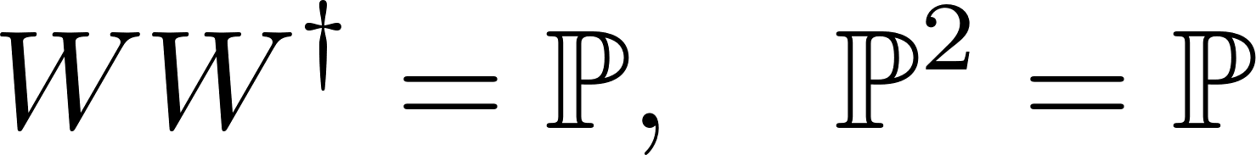
Isometries
Isometry:
Isometry condition:

Slide 10
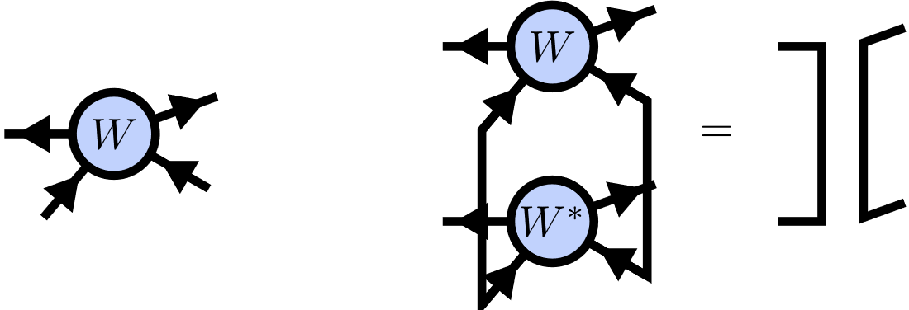
Isometric Tensors

Slide 11
Canonical Form
TODO: Left/right isometry condition
Finite MPS

Slide 12
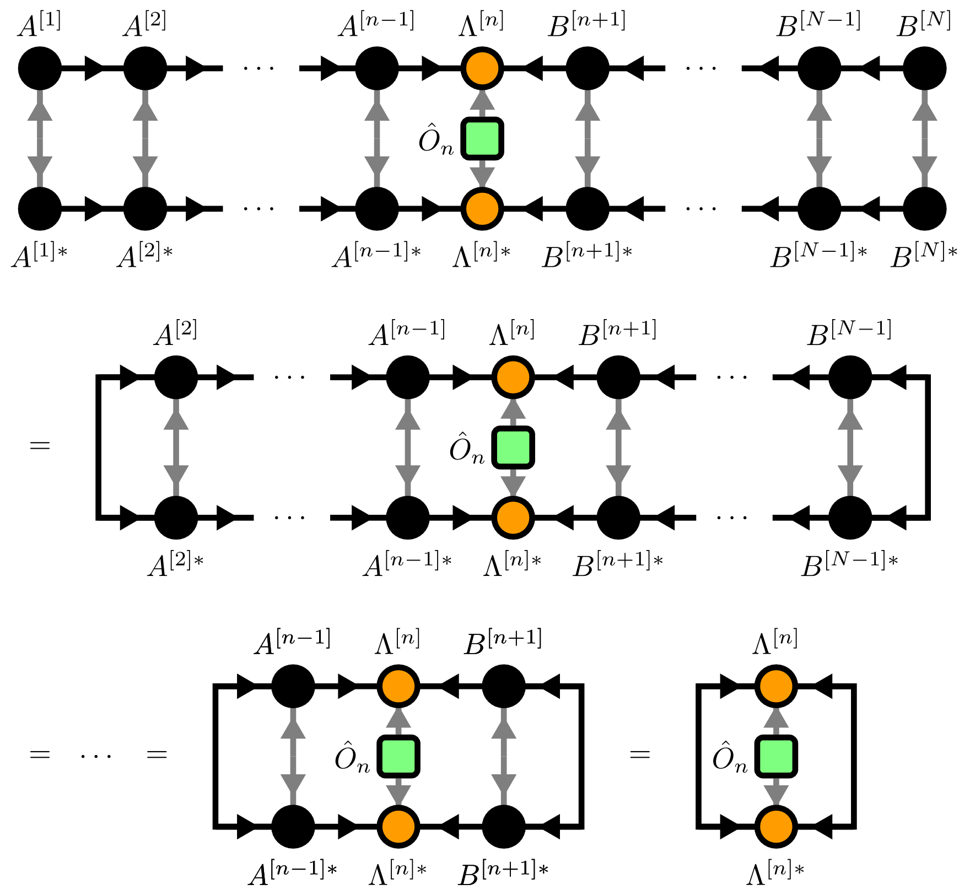
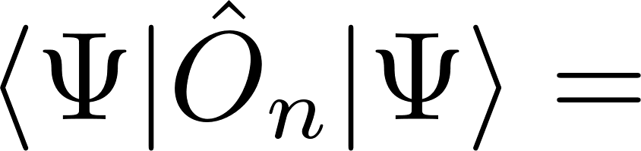
Local Expectation Values
TODO: Einzeln erscheinen lassen, finite MPS

Slide 13
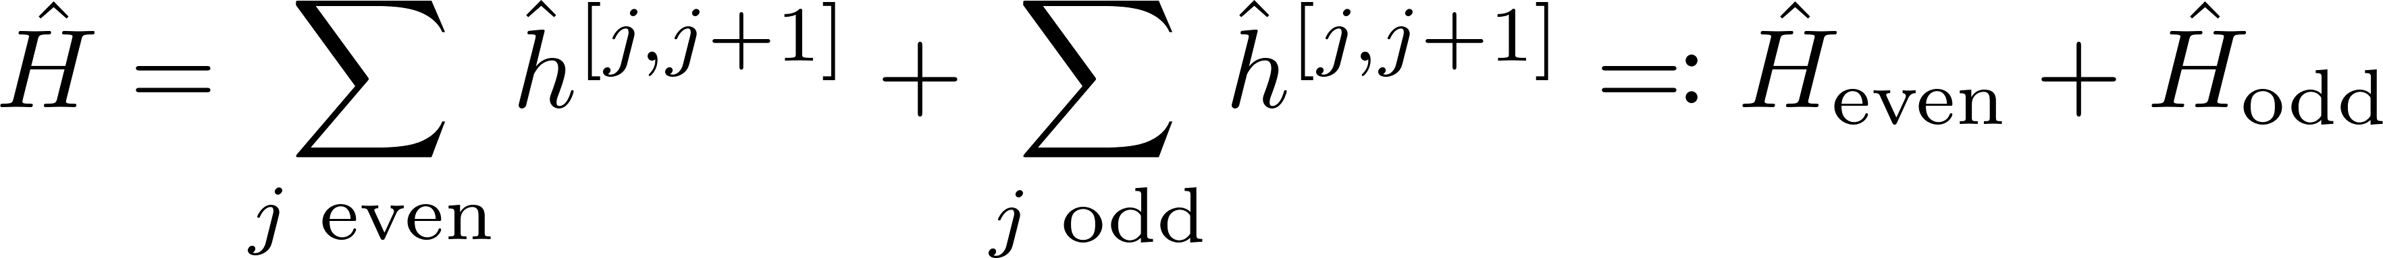
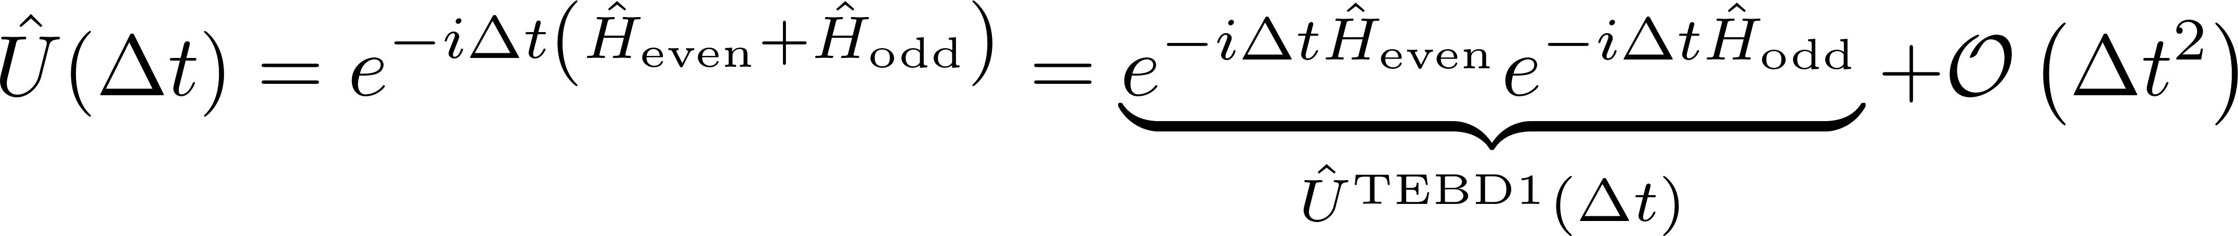
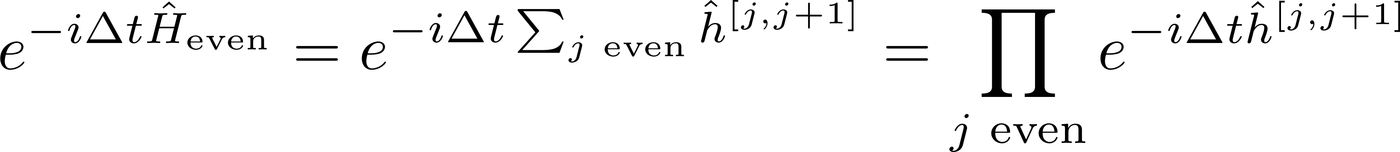
Time evolution

Slide 14

Time evolution
Schrödinger equation:
Hamiltonian
Suzuki-Trotter decomposition:

Slide 15
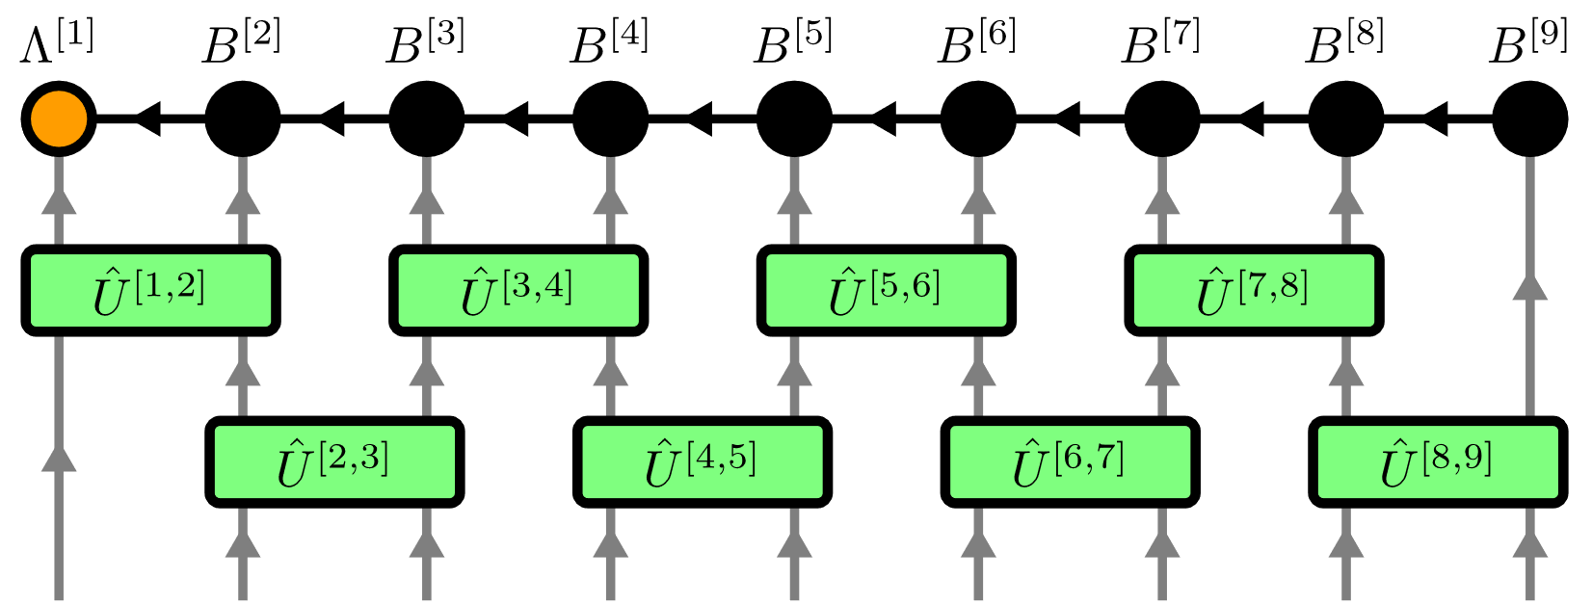
Time Evolving Block Decimation (TEBD)

Slide 16
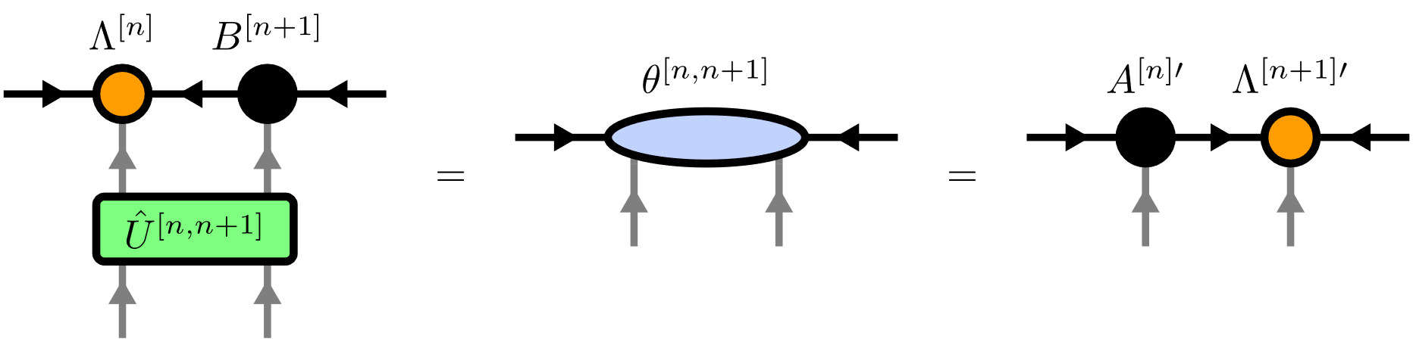
Time Evolving Block Decimation (TEBD)

Slide 17
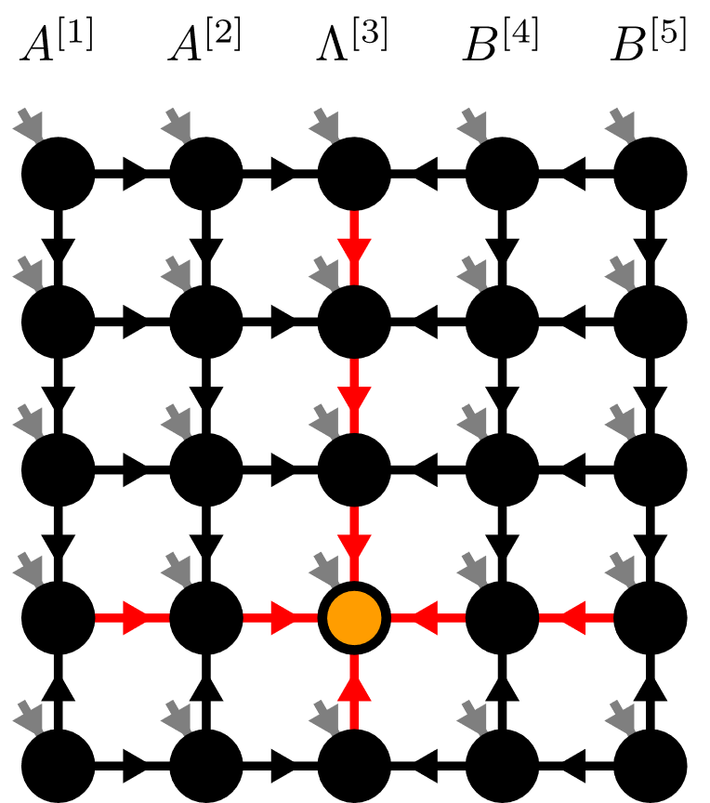
Contents
Matrix Product States (MPS)
Isometric Tensor Product States (isoTPS)
YB-isoTPS

Slide 18
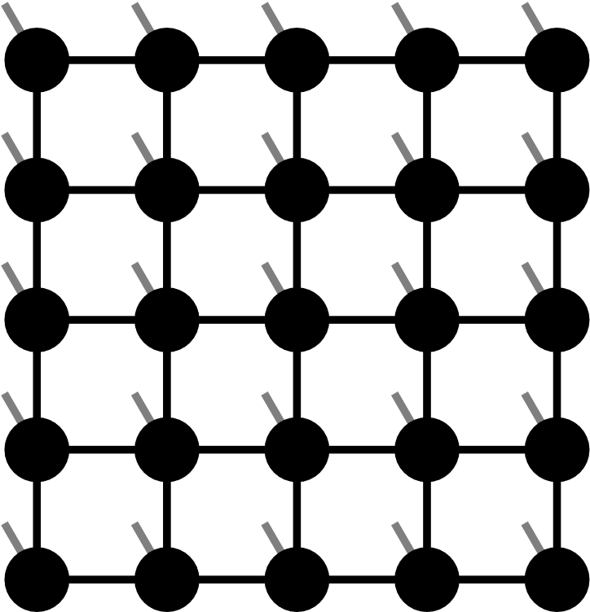
Projected Entangled Pair States (PEPS)

Slide 19
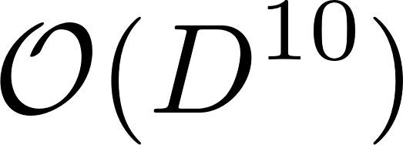
Projected Entangled Pair States (PEPS)
TEBD:

Slide 20
Isometric Tensor Product State

Slide 21
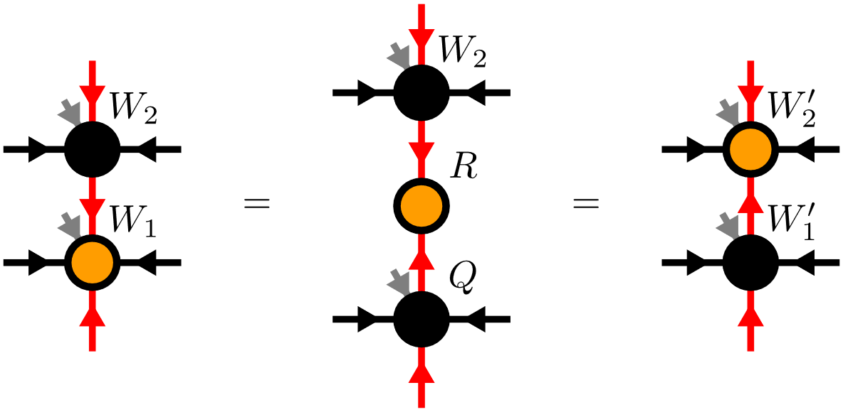
Moving the Orthogonality Center

Slide 22
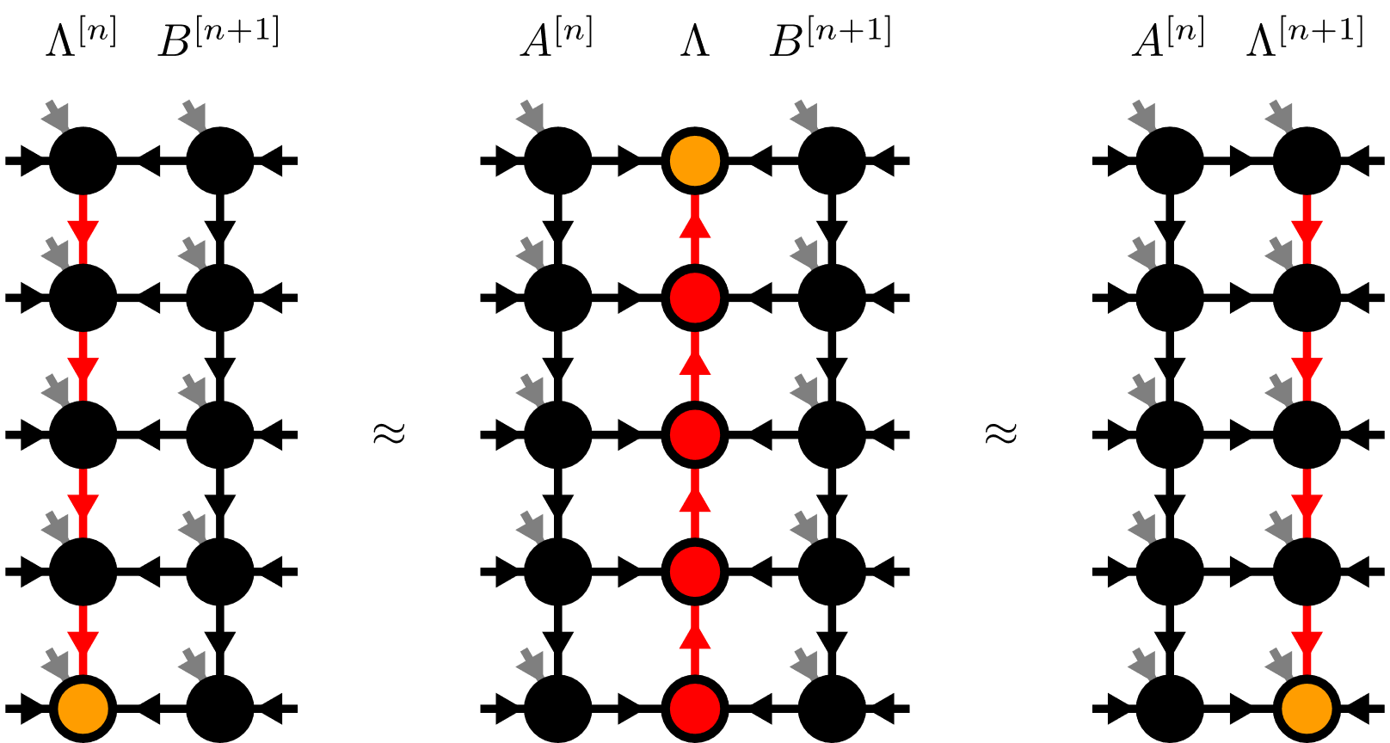
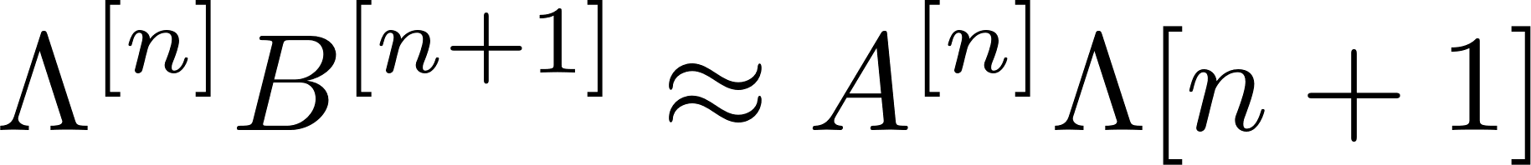
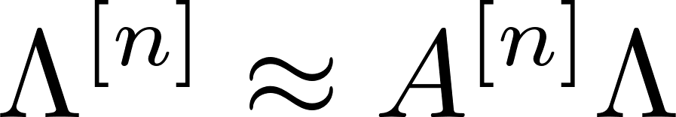

Moving the Orthogonality Hypersurface

Slide 23
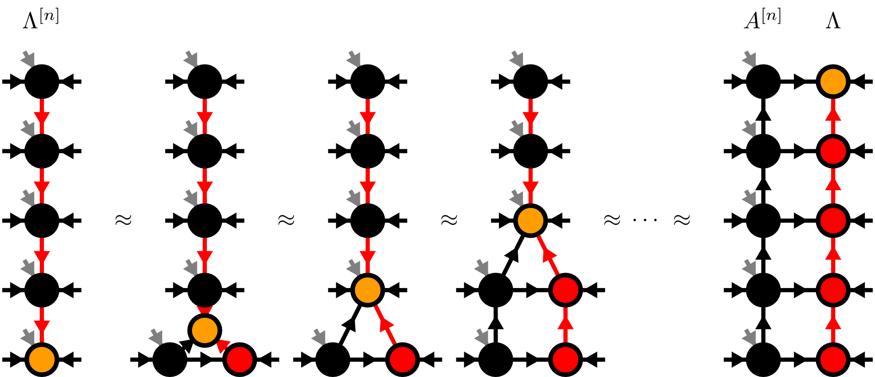
Moses-Move (MM)

Slide 24
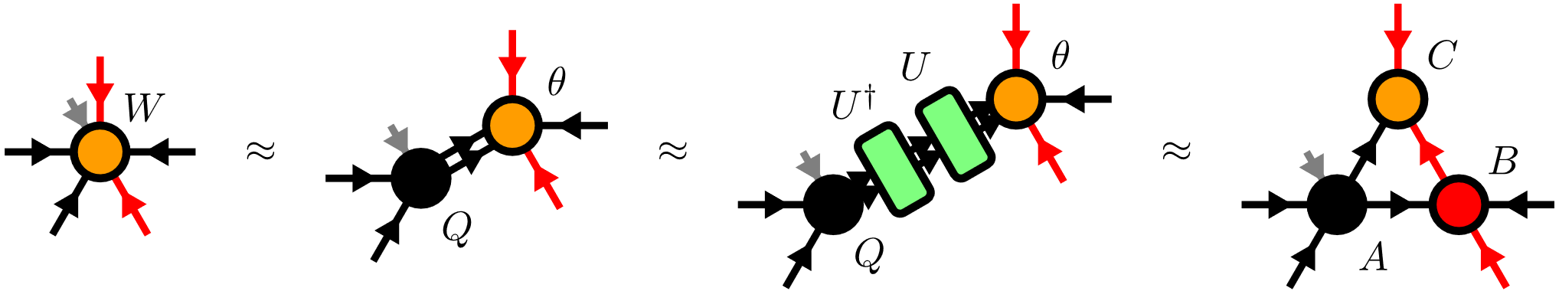
Moses-Move (MM) – Tripartite Decomposition

Slide 25
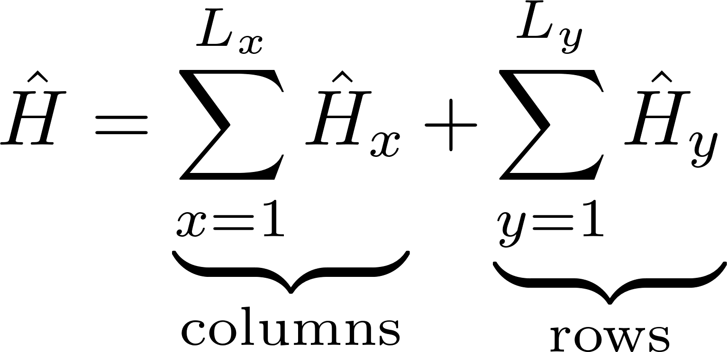
TEBD

Slide 26
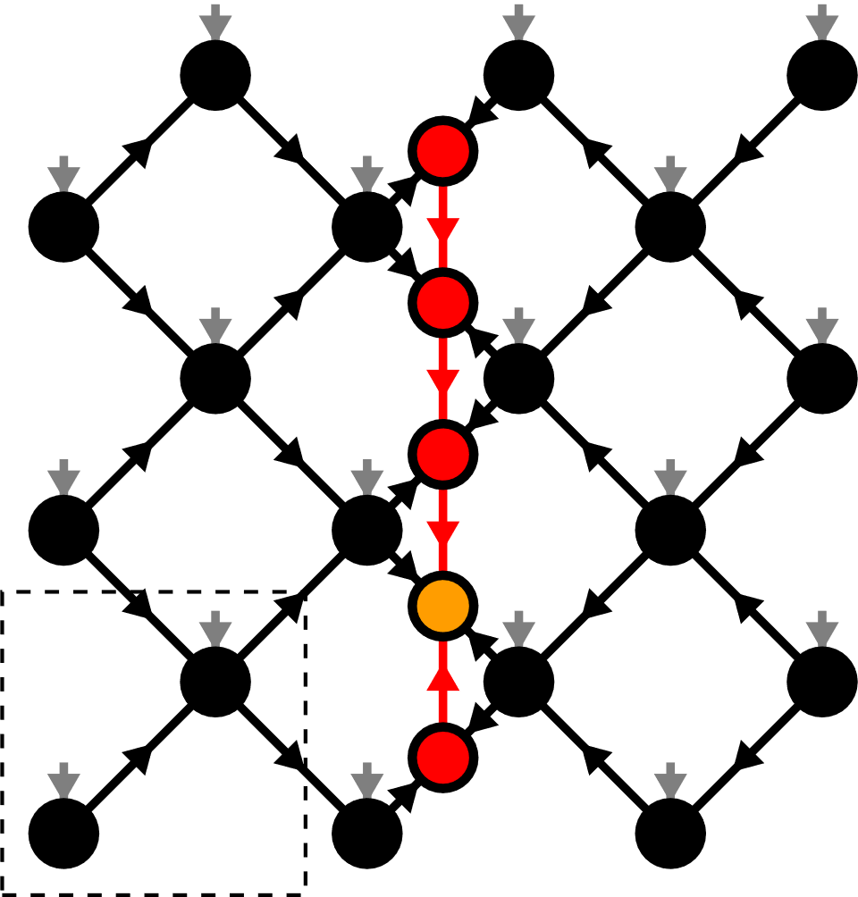
Contents
Matrix Product States (MPS)
Isometric Tensor Product States (isoTPS)
YB-isoTPS

Slide 27
YB-isoTPS

Slide 28
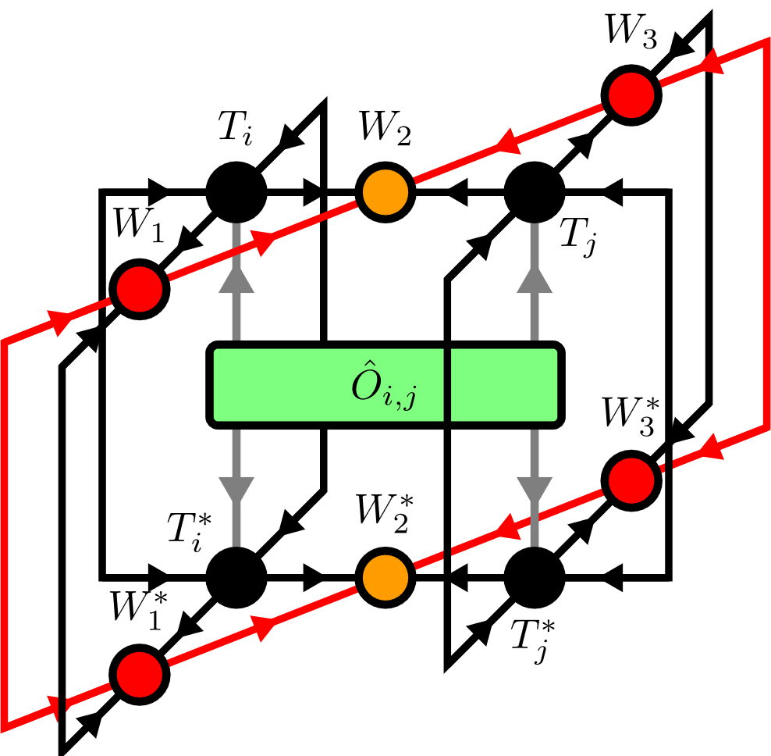
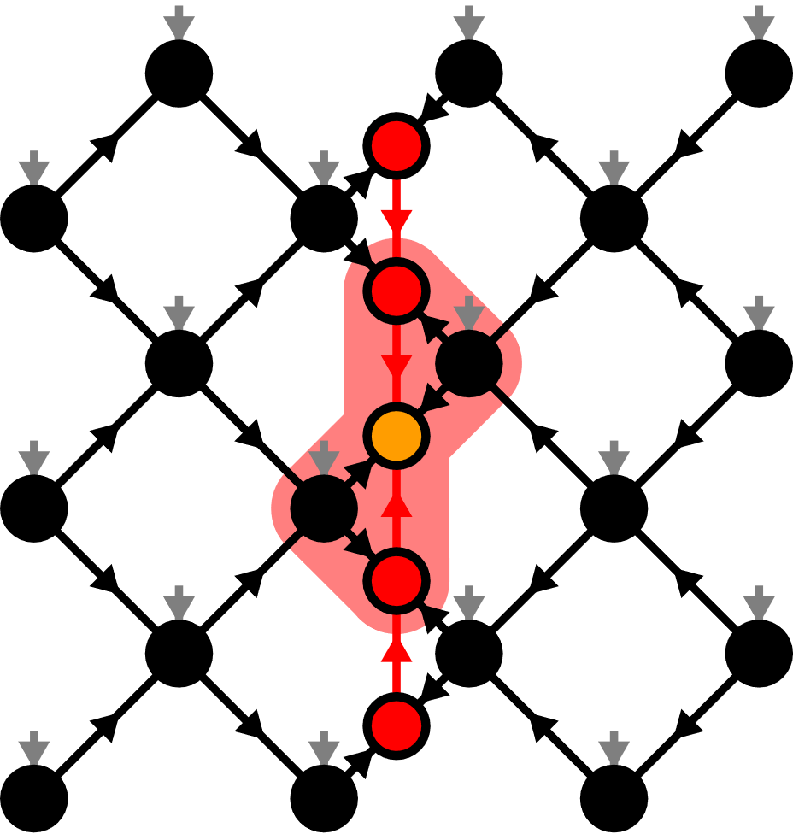
Local Expectation Values

Slide 29
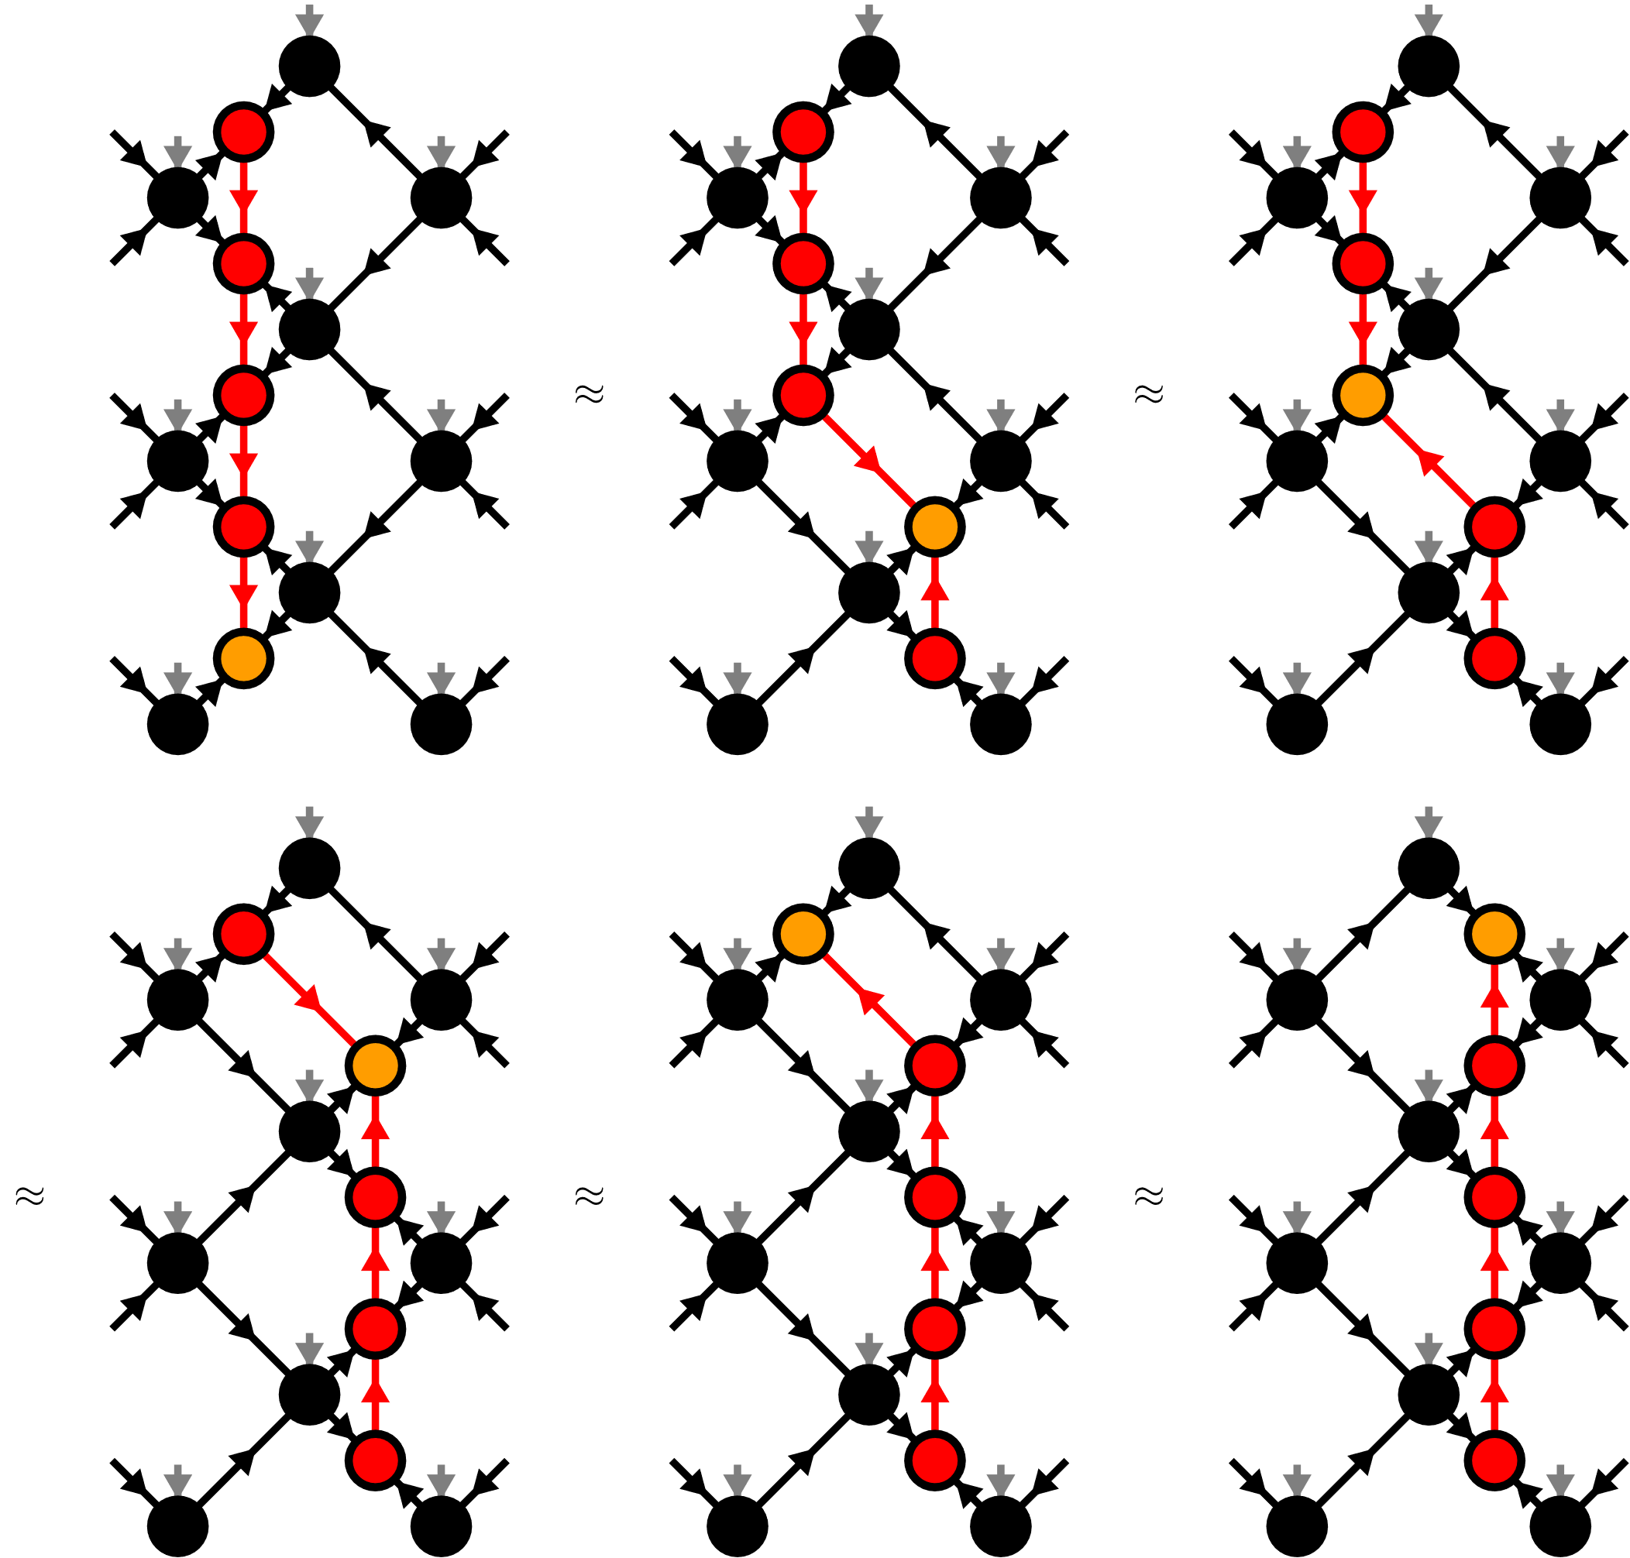
Moving the orthogonality hypersurface

Slide 30
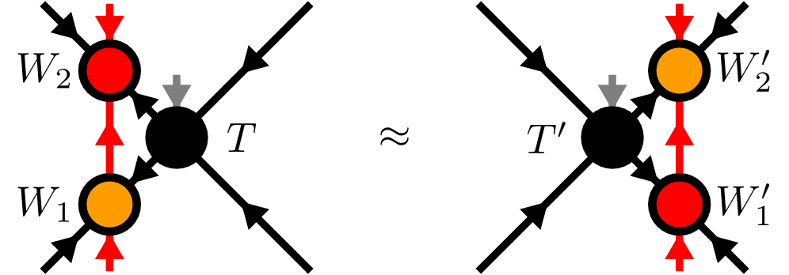
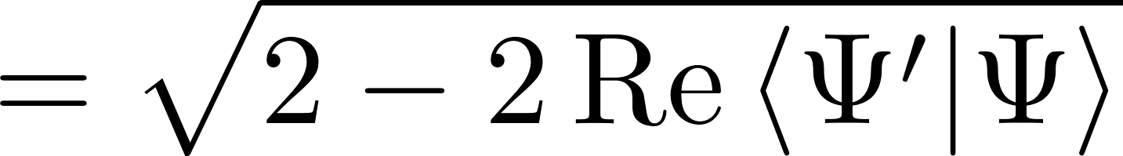
Yang-Baxter (YB) Move
YB Error

Slide 31
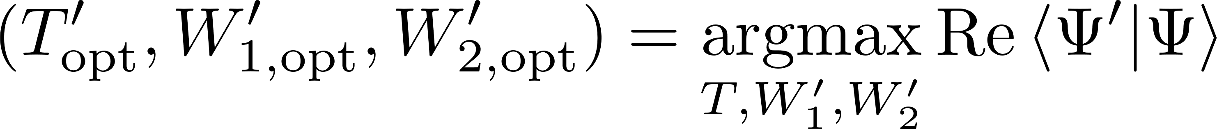
Yang-Baxter (YB) Move
Constrained optimization problem
Two algorithms:
Variational optimization with local updates
Tripartite decomposition using SVD + disentangling

Slide 32
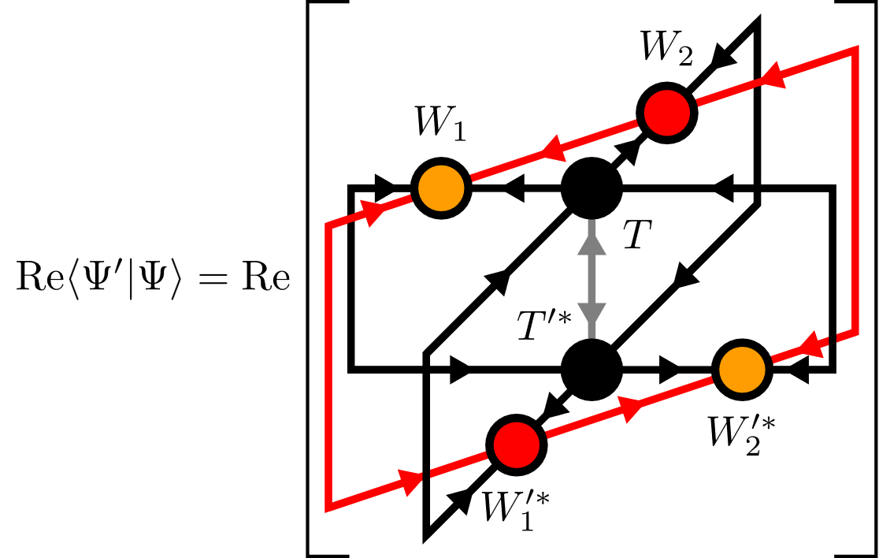

YB-move: Variational optimization

Slide 33
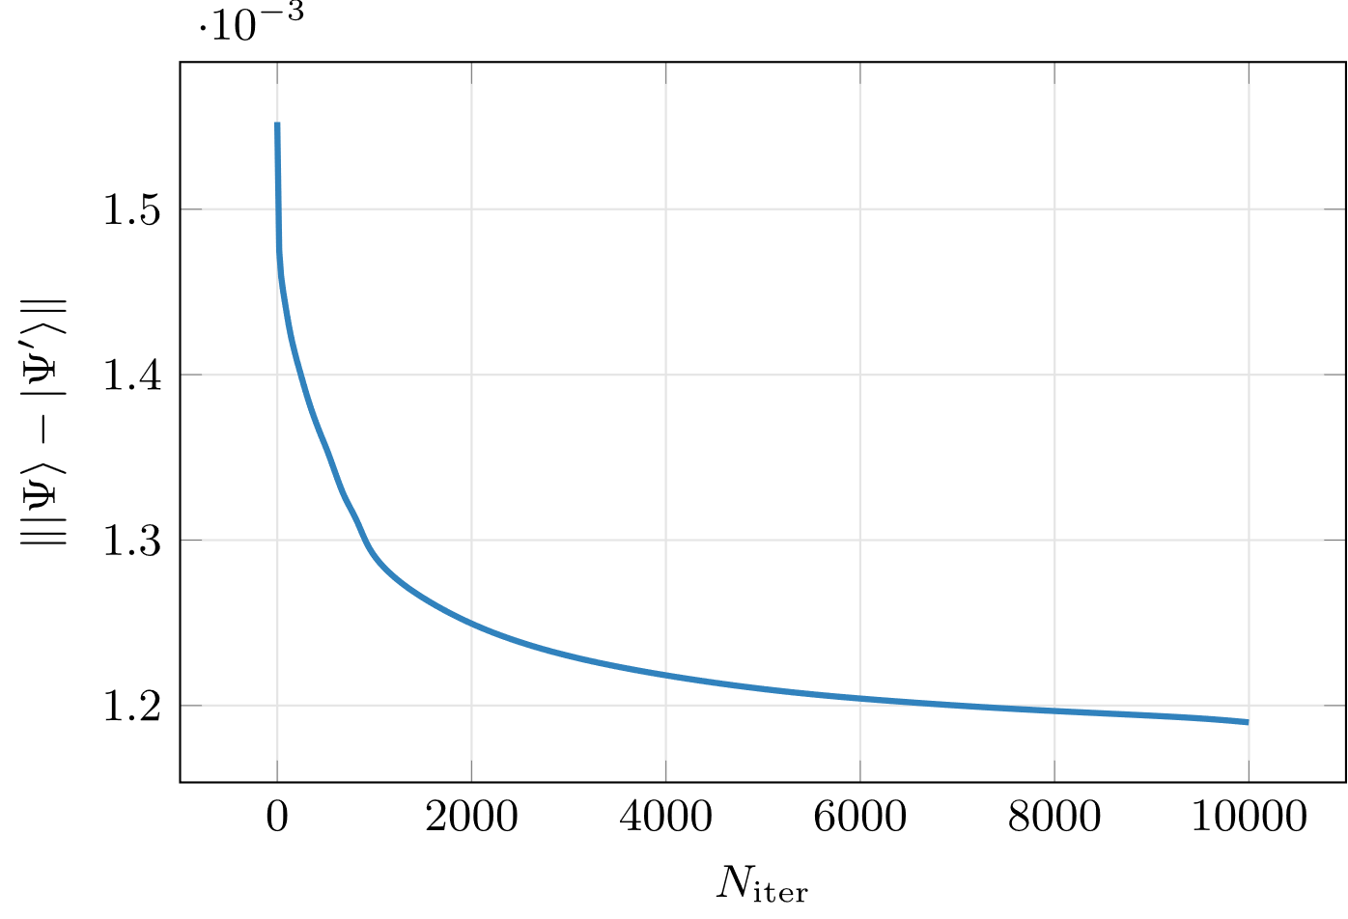
YB-move: Variational optimization

Slide 34
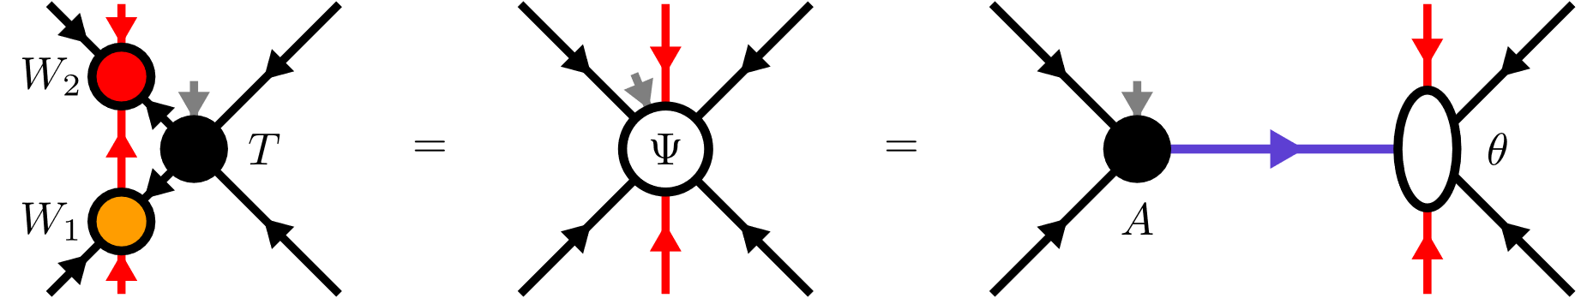
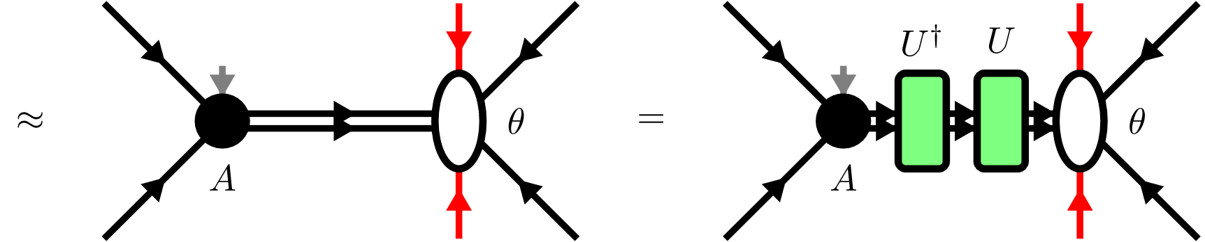
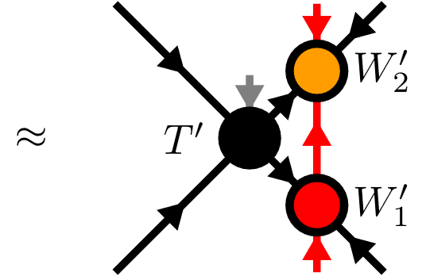
YB-move: Tripartite decomposition

Slide 35

Disentangling procedure

Slide 36



Disentangling procedure
Cost functions:
Truncation error
Renyi-entropy
with

Slide 37




Renyi-2 disentangling
maximize

Slide 38

Renyi-2 disentangling

Slide 39

Riemannian optimization
No easy tensor network form for cost functions
Use Riemannian optimization!

Slide 40


Riemannian optimization
Gradient:

Slide 41

Approximate Gradients

Slide 42

Approximate Gradients
Gradients:

Slide 43

YB-move: Comparison

Slide 44


TEBD: Local updates
Apply local bond operator:
Maximization problem

Slide 45


TEBD: Local updates

Slide 46







TEBD1

Slide 47






TEBD2

Slide 48


Transverse Field Ising (TFI) model
Critical field

Slide 49



Comparing YB-move algorithms

Slide 50


Comparing YB-move algorithms

Slide 51


Comparing YB-move algorithms

Slide 52

Comparing YB-move algorithms

Slide 53


TEBD1 vs TEBD2

Slide 54




Larger lattices

Slide 55

Larger lattices

Slide 56

Real-time evolution: Global quench

Slide 57
Summary & Outlook
TODO
New canonical form
YB move scales worse than MM
Nevertheless YB-isoTPS are cool
Easy generalization: show Honeycomb
Outlook: DMRG, GPU, etc

